Slide 1





Examination System
Ashraf El Nagar
Khaled Eleraky
Nada Mustafa
Heba Abdelmaged

Slide 2
Topics
Entity Relationship Diagram (ERD)
Mapping
Database Structure Implementation
Data Integration
Stored procedures
Database Documentation
Desktop Application
Paginated Reports using SSRS
Dashboard using Power BI

Slide 3
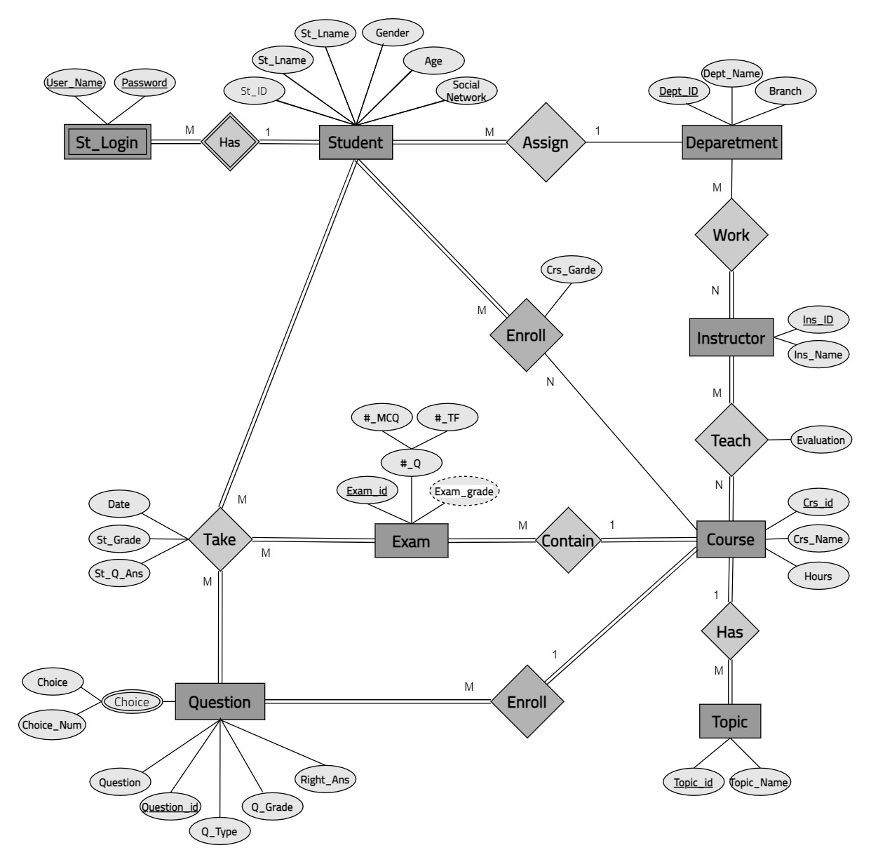
ERD

Slide 4
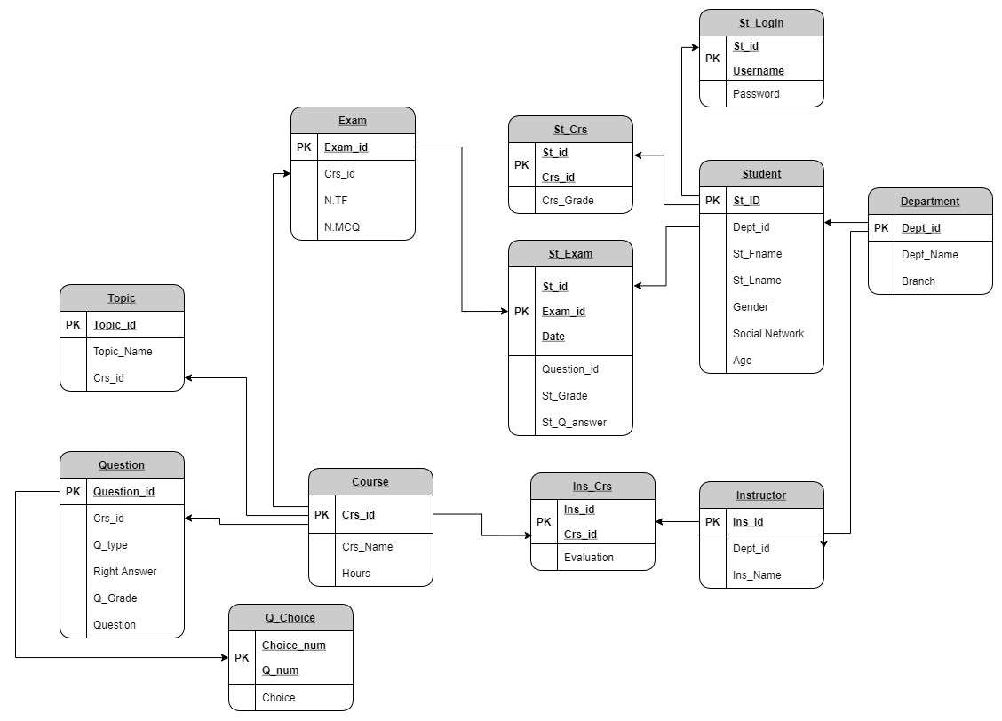
Mapping

Slide 5

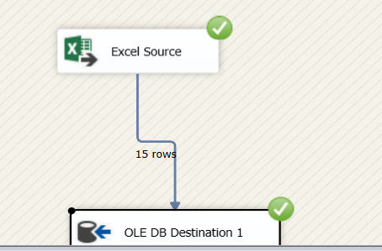
Data Integration
XML Files
Excel Files

Slide 6
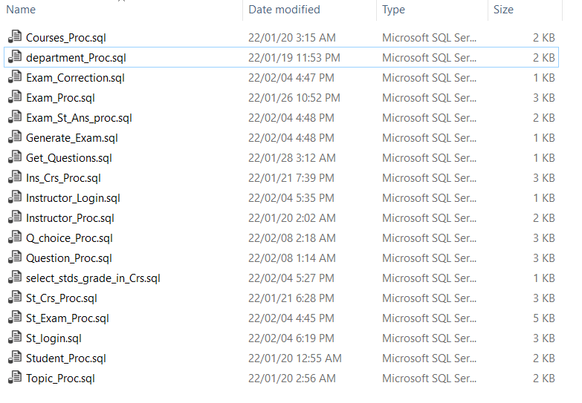
Stored Procedures

Slide 7
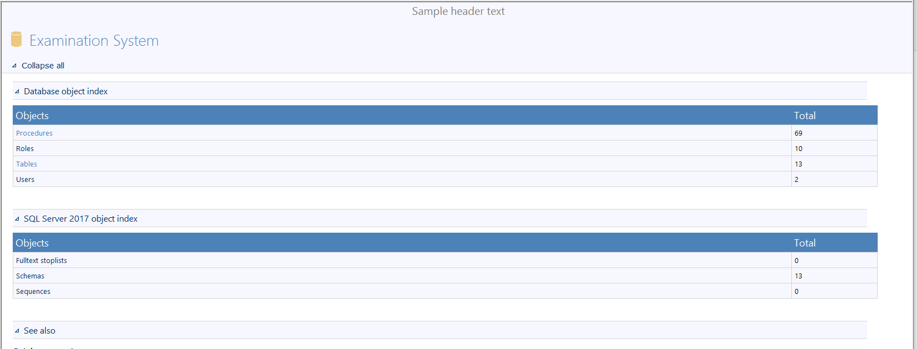

Database Documentation using ApexSQL Tool

Slide 8

Desktop App

Slide 9
Reports Using SSRS
Students in specific track.
Grades of student in his courses.
Courses of instructors and number of students per course.
Topics of course.
Questions of exam.
Student answer in his exam and questions of exam.

Slide 10
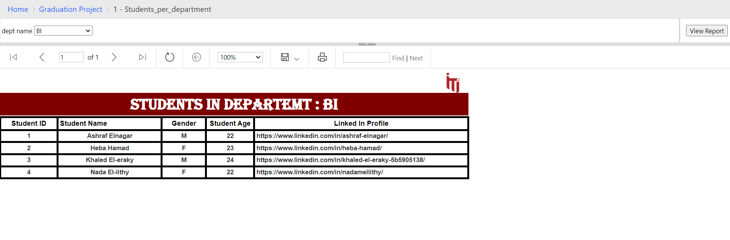
1 - Students per track

Slide 11
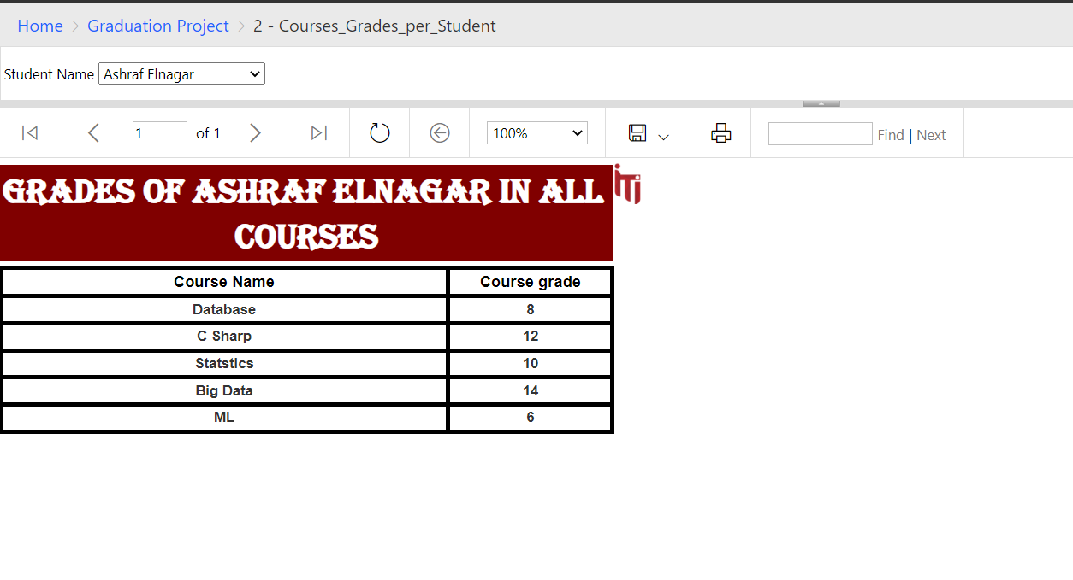
2 - Student Grades of Courses

Slide 12
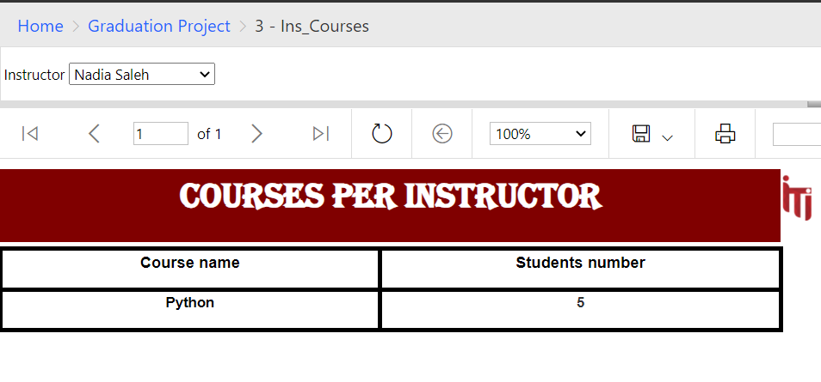
3 - Courses per Instructor

Slide 13
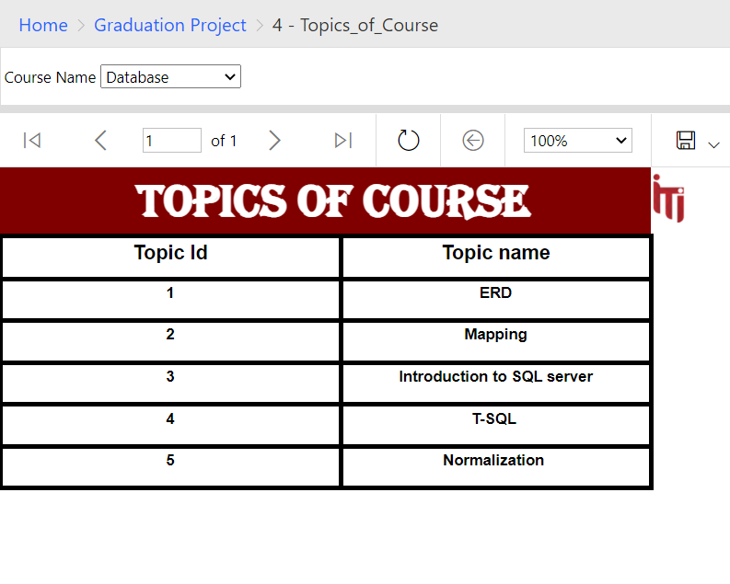
4 – Topics of Courses

Slide 14
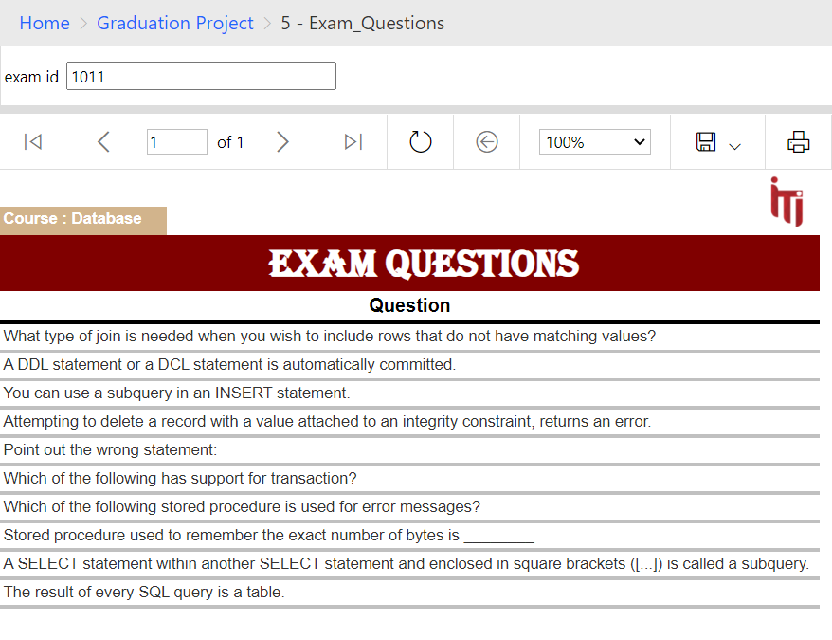
5 – Exam Questions

Slide 15
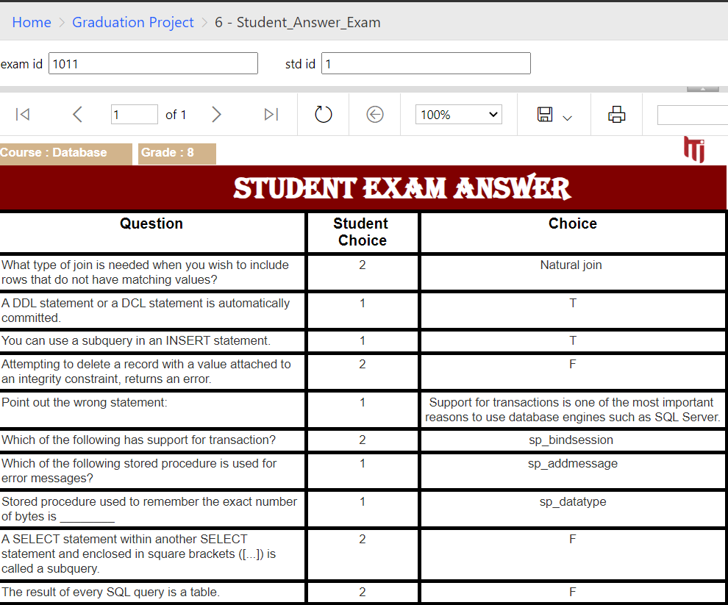
6 – Student’s Exam Answers

Slide 16




Dashboards
Student
Branch
Course

Slide 17
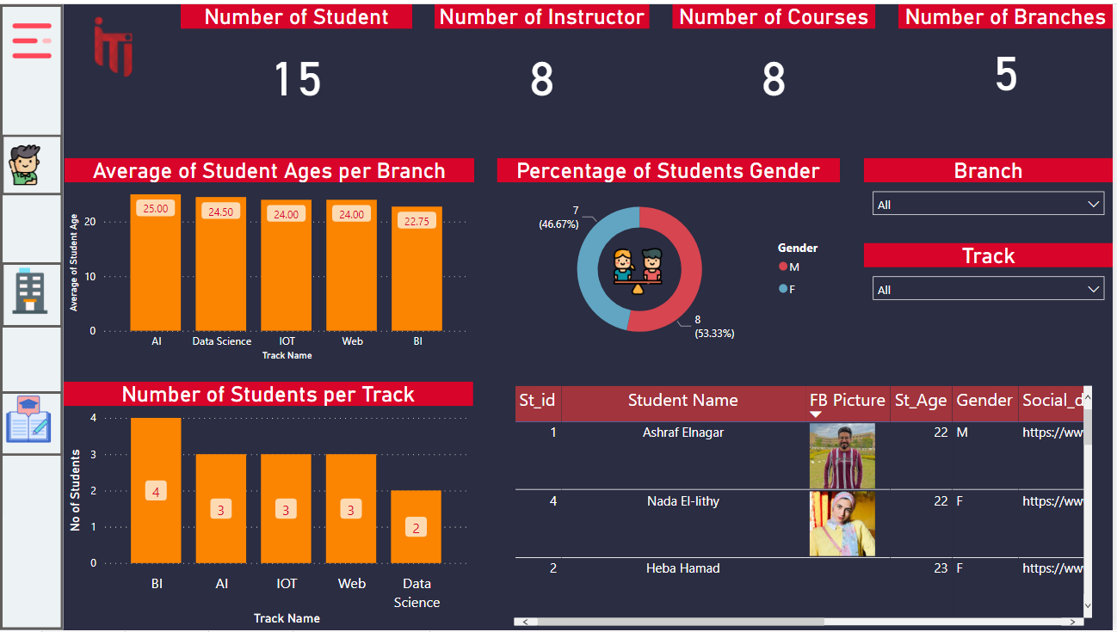

Slide 18
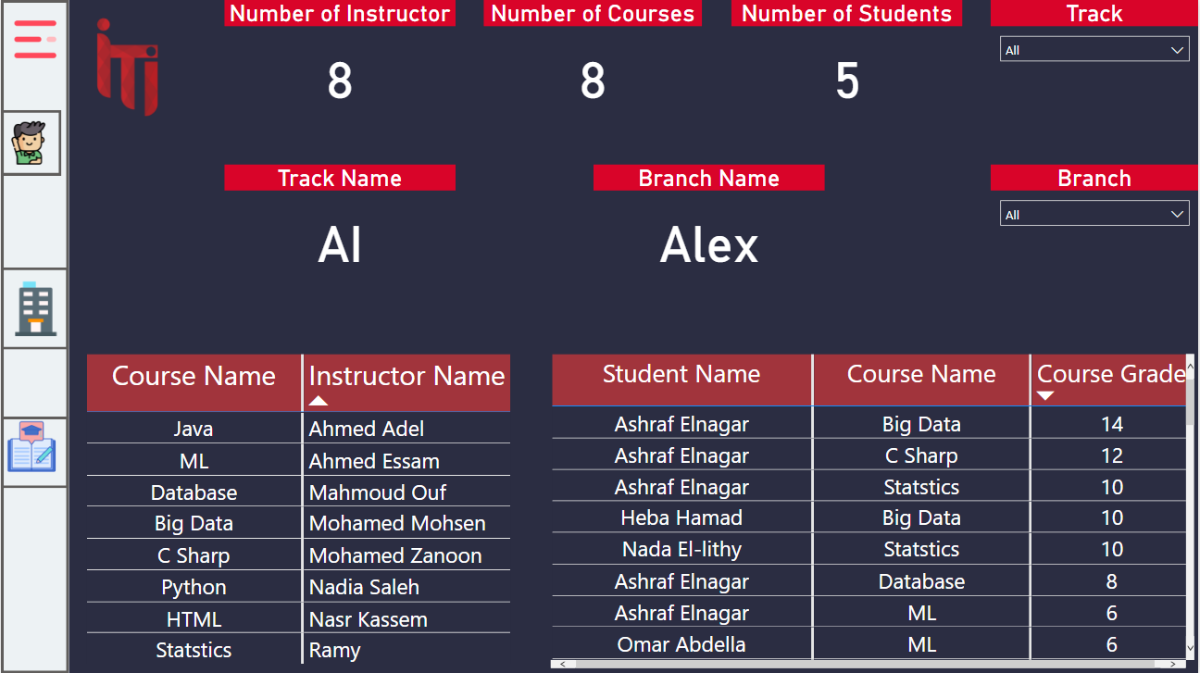

Slide 19
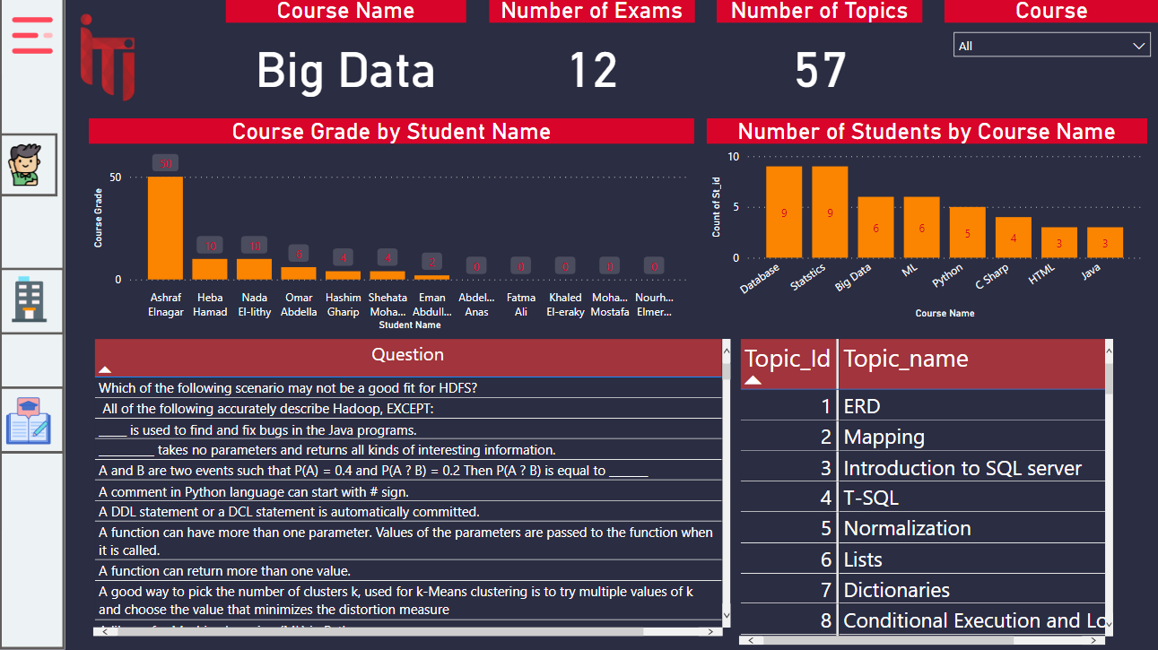

Slide 20
Thank You .

